Slide 1
FROM SENTIMENT ANALYSIS TO PERSUASION ANALYSIS
Abhinaya Murugesan [A0163311W]
Allen Geoffrey Raj [A0163398R]
Pawaskar Sharvina Dileep [A0163302W]
Rajkumar Preethi Jennifer [A0163190L]
Ram Nagarajan [A0163247E]

Slide 2
DEFINITIONS
SENTIMENT ANALYSIS: Sentiment analysis refers to the use of natural language processing, text analysis, computational linguistics, and biometrics to systematically identify, extract, quantify, and study affective states and subjective information.
PERSUASION can attempt to influence a person's beliefs, attitudes, intentions, motivations, or behaviors. In business, persuasion is a process aimed at changing a person's (or a group's) attitude or behavior toward some event, idea, object, or other person(s), by using written or spoken words to convey information, feelings, or reasoning, or a combination thereof.
PERSUASION ANALYSIS: Persuasion analysis involves focusing on the rhetoric that an author or speaker uses to make the writing/speech memorable. One can analyse the successive rhetoric patterns either for the purpose of predicting future works which exhibit similar patterns or to extract the words that engage the audience and drive the intended action.

Slide 3
SENTIMENT ANALYSIS – A Restrictive perspective towards Natural Language Processing
SAMPLE REVIEW:
Sentiment
Engaging language
The Chevy Camaro is a good car. It has several powerful engine options and handles extremely well. It also provides a fun driving experience without sacrificing ride quality. The front seats have all-day support, and there are plenty of user-friendly tech features. The Camaro is short on practicality, however. Its rear seat and trunk are tiny, making it less useful as a daily driver.
WHAT
Sentiment
WHY
ACTIONABLE INSIGHT:
Utilise the Why to create engaging content for the audience
Engaging language

Slide 4

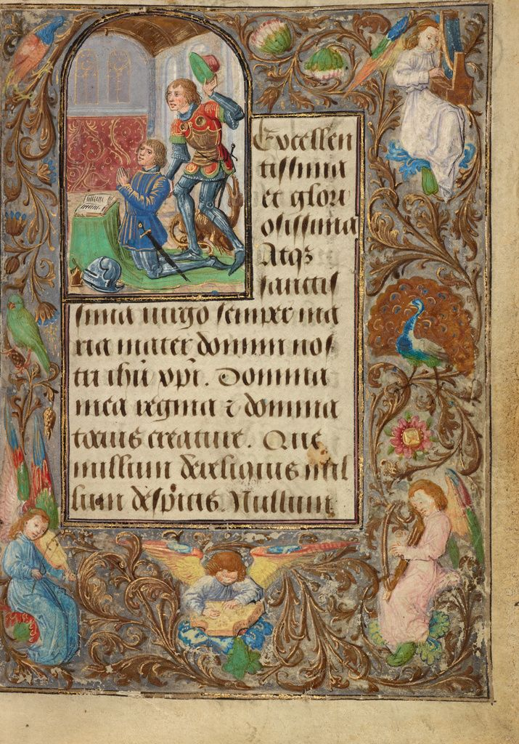
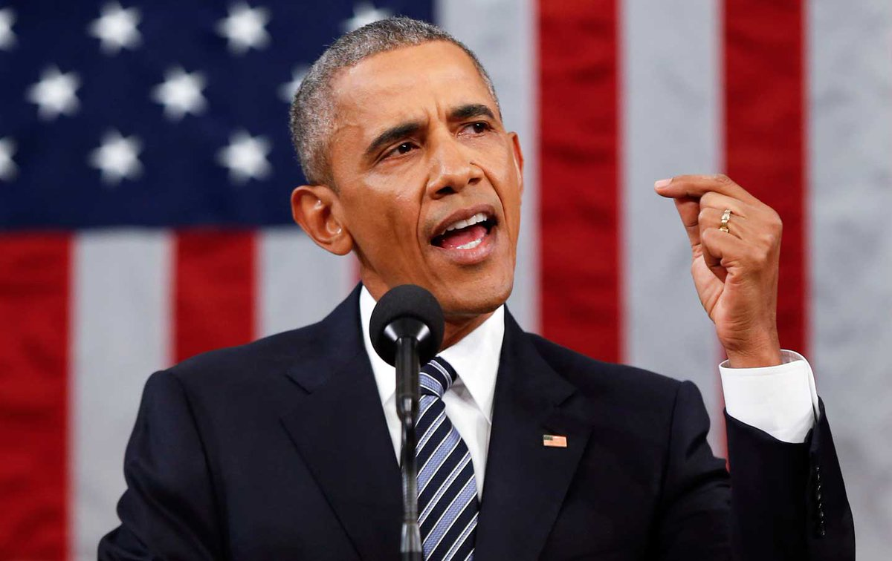
APPLCATIONS OF PERSUASION ANALYSIS
Creating engaging content to induce sales
Predict author of a novel/article/speech
Deliver winning speeches
LITERATURE REVIEW
A Rhetorical Analysis Approach to Natural Language Processing - Benjamin Englard
Dr. Michael M. Krop

Slide 5
Process –Overview
Goal: To find a way to extend the capabilities of computers through the
processing of language in a more human way
How?
Build a model to predict the author of a piece of text based on rhetoric strategies
Build a model to predict the winner of a presidential candidate’s election campaign based on
rhetorical strategies within that president’s inaugural address
Combine Rhetorical Analysis with Natural Language Generation to generate pieces of text that resemble specific authors

Slide 6

BUILDING THE MODEL
Identify 6 Rhetorical Strategies
Dash
Semi colon
Alliteration
Anaphora
Epistrophe
Parallelism
Parallelism
repeating the grammatical structure in consecutive phrases for emphasis
“of the people, for the people, by the people” - Abraham Lincoln
Emphasis on the words following the pause
Epistrophe
ending consecutive sentences with same words or phrases for emphasis
“Who is here so base that would be a bondman? If any, speak; for him have I offended. Who is here so rude that would not be a Roman? If any, speak; for him have I offended’
Alliteration
series of words with the same consonant
“In all his greatness and his glory”
Anaphora
starting consecutive sentences with same words or phrases for emphasis
“I have a dream” – Martin Luther King Jr

Slide 7
BUILDING THE MODEL
Implementing Rhetoric Strategy Finders:
6 Finder Programs
Data Source:
Brown Corpus
Word Tokenize
Train data
Unigram part of speech tag
pseudo code for pattern matching algorithm of rhetoric strategies – returns count
Unit test the Finder Programs

Slide 8
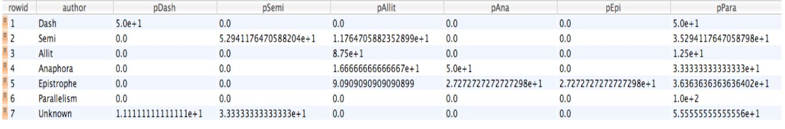
PREDICTING THE AUTHOR OF AN UNKNOWN ARTICLE
AUTHOR NAME | TEXT FILE
William Shakespeare | Macbeth
John Milton | Paradise Lost
Herman Melville | Typee
Lewis Carroll | Alice's Adventures in Wonderland
CONCEPT:
The difference in the authors style of writing lies in the rhetoric strategies that they use
Loop through each row in the table and open the text file
Send the file to each rhetoric strategy finder and return the count of occurrent in a new table
Divide the count by the total number of strategies found to determine the relative probability of each
strategy
SQLite Table of Probabilities of Rhetorical Strategies for Test Files

Slide 9
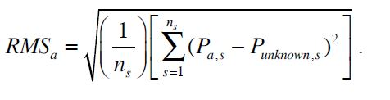
PREDICTING THE AUTHOR OF AN UNKNOWN ARTICLE
For the Unknown author the probabilities of each rhetotric strategy was found
Similarities between the unknown author and the authors for whom probability was calculated was found using Root Mean Square Error
n_{s} - no of strategies analysed
P_{a,s} - Author a’s Probability of Strategy s
P _{unknown,s} – unknown author’s probability for strategy s
RESULT:
The author with the smallest RMS error was returned as the author of the unknown piece of work
Model Accuracy:
The authors for unknown text was predicted with 100% accuracy

Slide 10
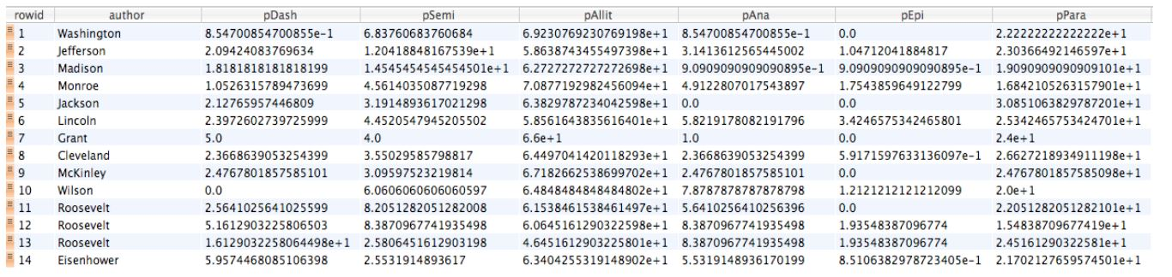
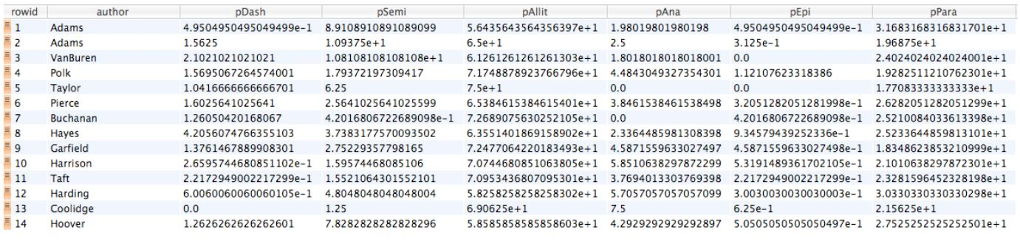
PREDICTING THE WINNER OF PRESIDENTIAL CANDIDATE ELECTION
MODEL ACCURACY:
The election results were predicted with 55% accuracy
FURTHER RESEARCH:
The average standard deviation between the winner average and loser average was only 0.7998
The average probability of all the winners and losers were calculated.
CONCEPT:
Similar process was followed as the author identification model except the data source for the winning election candidates and losing election candidates were taken in different tables
The candidate’s speech is compared against the average probability of the winning and losing speeches
RMS error of unknown candidate with the winner avg and loser avg was calculated separately
The avg with which the RMS error is minimum is considered the election outcome
SQLite Table of Probabilities of Rhetorical Strategies of Presidents who gave an inaugural address and were re-elected
SQLite Table of Probabilities of Rhetorical Strategies of Presidents who gave an inaugural address and were not re-elected.

Slide 11
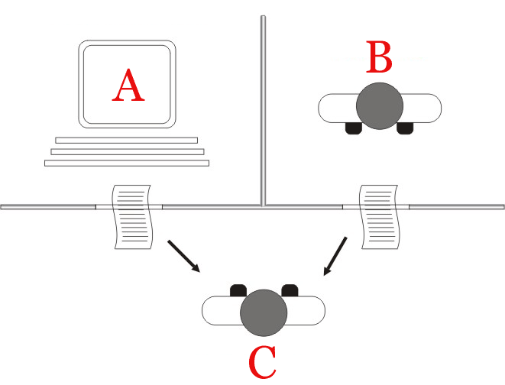
GENERATING TEXT THAT RESEMBLE AUTHORS WRITING STYLE
Machines will have truly become “intelligent”, when humans will not be able to discern whether they are speaking to a human or a machine during a conversation – Alan Turing
Concept:
rhetorical strategies give an author or speaker a distinct style
Goal: To take the probabilities of the 6 strategies as input and output sentences that resemble the author’s style
Step 1: Create a text piece using WordNet Dictionary
Input a word
The definition of the word is found using WordNet and the middle word of the definition is added to the first word in a recursive manner
Turning Test

Slide 12
GENERATING TEXT THAT RESEMBLE AUTHORS WRITING STYLE
Step 2:Develop a method to input the rhetorics into the output text
Randomly add dashes and semi colons based on probability
The other rhetorics were already present during the sentence generation
“Bird characterized character”
Step 3:Test against 3 of author’s work and normalise
Results shown in next slide
Step 4:Randomise the word added from the definition
Results shown in next slide

Slide 13
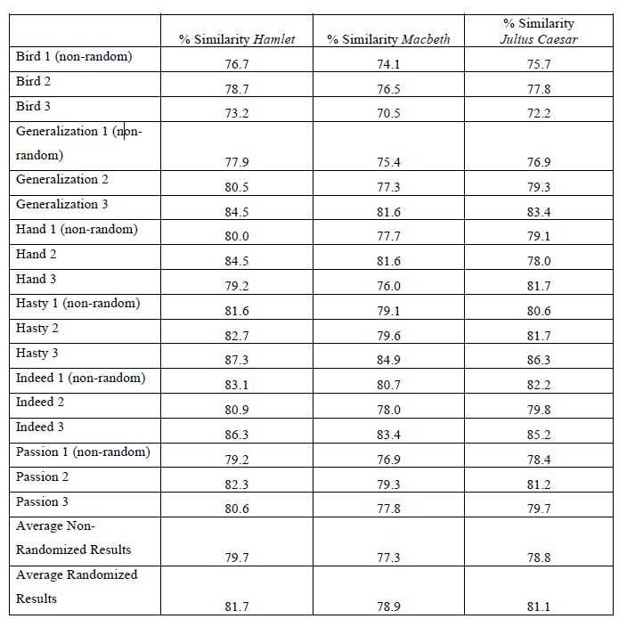
Results

Slide 14
FUTURE SCOPE
Include more rhetoric styles such as irony and apophosis to increase the accuracy
The rhetorics such as dash and semicolon can be used for other languages.
Prediction of author styles can help identify plagiarism.
Our Perspective:
For Natural Language Text Generation, the other 5 rhetoric styles can be deliberately added
Probability of the 6 rhetorics should not be given as input as we are eventually comparing the output sentence with the other works of the author based on the probability. Hence we cannot give as an input a measure which will be used to gauge the performance of the model

